Slide 1

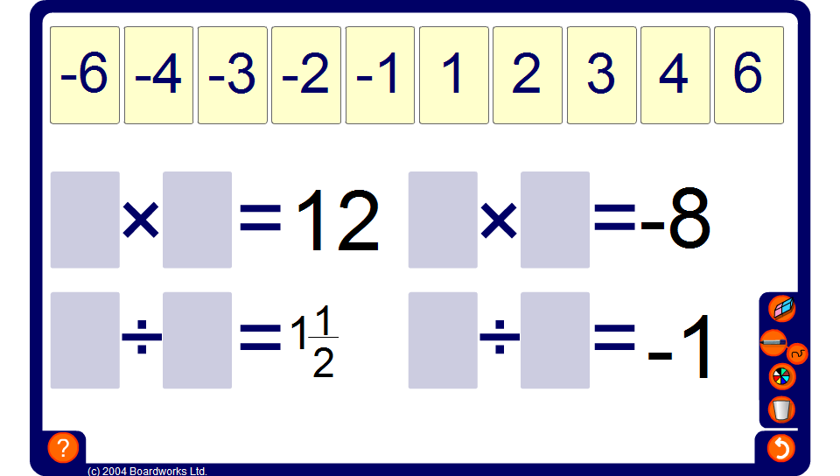


Integer cards – multiplication and division
Notes:
Challenge pupils to find every possible solution for each calculation using the given set of integer cards.
Establish that if the answer to the calculation is negative the signs of the numbers we are multiplying or dividing must be different (one positive and one negative). If the answers to the calculations is positive the signs of the numbers we are multiplying or dividing must be the same (both positive or both negative).

